Slide 1
Model Evaluation and Selection
Evaluation metrics: How can we measure accuracy? Other metrics to consider?
Use validation test set of class-labeled tuples instead of training set when assessing accuracy
Some of the measures are:
Accuracy – suitable when class tuples are evenly distributed
Precision - suitable when class tuples are not evenly distributed
Recall - Sensitivity
1

Slide 2
Classifier Evaluation Metrics: Confusion Matrix
Confusion Matrix:
Actual class\Predicted class | Yes | No
Yes | True Positives (TP) | False Negatives (FN)
No | False Positives (FP) | True Negatives (TN)
Actual class\Predicted class | C₁ | ¬ C₁
C₁ | True Positives (TP) | False Negatives (FN)
¬ C₁ | False Positives (FP) | True Negatives (TN)
Given m classes, an entry, CM_{i,j} in a confusion matrix indicates # of tuples in class i that were labeled by the classifier as class j
May have extra rows/columns to provide totals
2

Slide 3
Classifier Evaluation Metrics: Confusion Matrix
True Positives
Postive tuples correctly classified as positive.
True Negatives:
Negative tuples correctly classified as negative.
False Positives:
Negative tuples incorrectly classified as positives.
False Negatives:
Positive tuples incorrectly classified as negatives
3

Slide 4
Classifier Evaluation Metrics: Confusion Matrix
Confusion Matrix:
Actual class\Predicted class | C₁ | ¬ C₁
C₁ | True Positives (TP) | False Negatives (FN)
¬ C₁ | False Positives (FP) | True Negatives (TN)
Example of Confusion Matrix:
Actual class\Predicted class | buy_computer = yes | buy_computer = no | Total
buy_computer = yes | 1 | 0
buy_computer = no | 1 | 998
Total |  |  | 1000
Given m classes, an entry, CM_{i,j} in a confusion matrix indicates # of tuples in class i that were labeled by the classifier as class j
May have extra rows/columns to provide totals
4

Slide 5
Classifier Evaluation Metrics: Accuracy, Error Rate, Sensitivity and Specificity
A\P | C | ¬C
C | TP | FN | P
¬C | FP | TN | N
 | P’ | N’ | All
Classifier Accuracy, or recognition rate: percentage of test set tuples that are correctly classified
Accuracy = (TP + TN)/All
Error rate: 1 – accuracy, or
Error rate = (FP + FN)/All
5

Slide 6
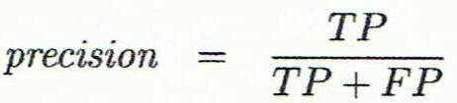
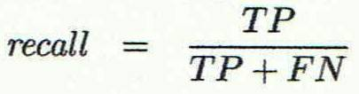
Classifier Evaluation Metrics: Precision and Recall, and F-measures
Precision: exactness – what % of tuples that the classifier labeled as positive are actually positive
Recall: completeness – what % of positive tuples did the classifier label as positive?
Perfect score is 1.0
6

Slide 7
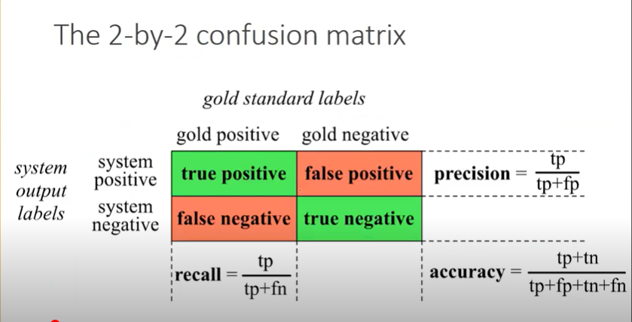

Slide 8
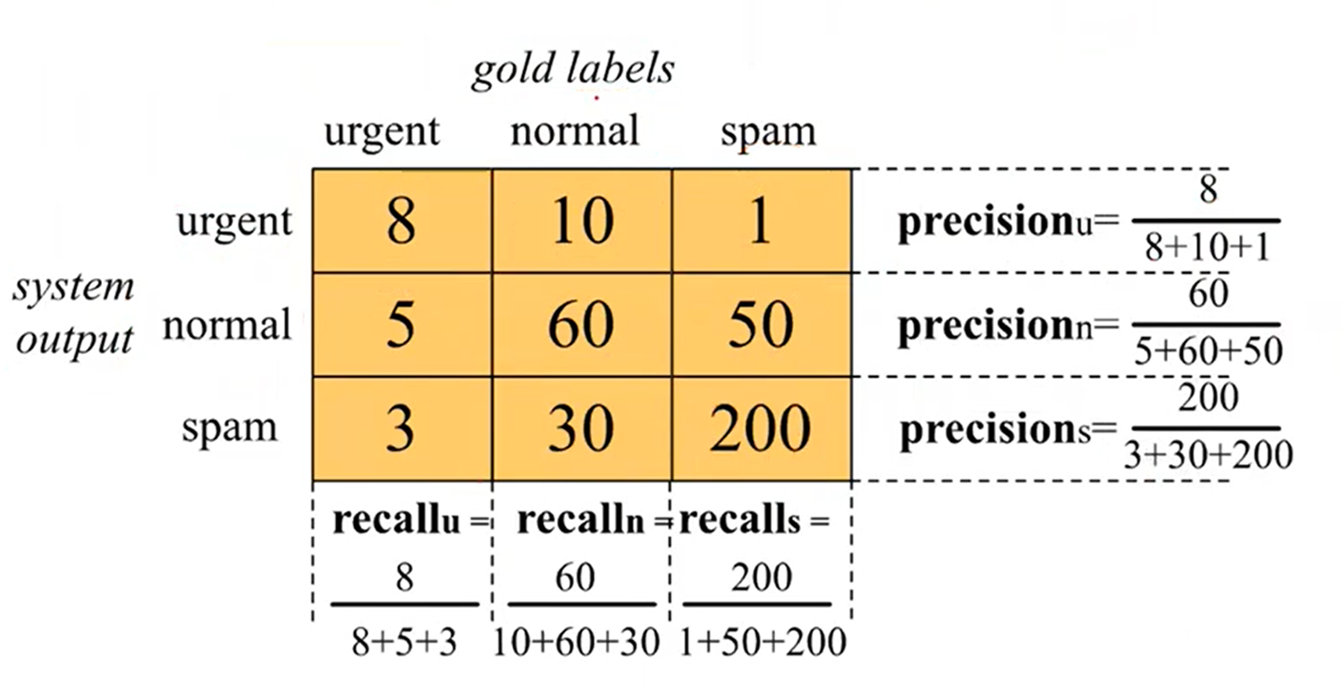
Confusion matrix for 3 class classifiation
Notes:
Macro-average gives equal weight to each class, regardless of the number of instances. Micro-averaging, on the other hand, aggregates the counts of true positives, false positives, and false negatives across all classes and then calculates the performance metric based on the total counts.

Slide 9
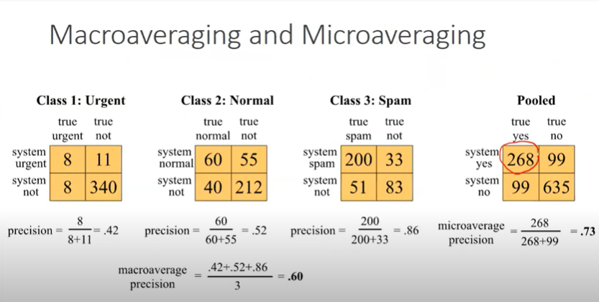

Slide 10
Macro-average gives equal weight to each class, regardless of the number of instances. Micro-averaging, on the other hand, aggregates the counts of true positives, false positives, and false negatives across all classes and then calculates the performance metric based on the total counts.

Slide 11
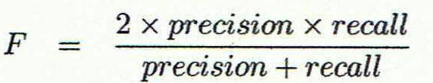
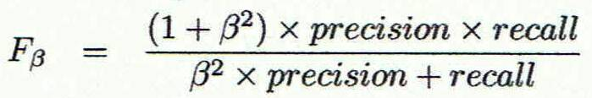
Classifier Evaluation Metrics: Precision and Recall, and F-measures
The F-score is a way of combining the precision and recall of the model, and it is defined as the harmonic mean of the model’s precision and recall.
Inverse relationship between precision & recall
F measure (F₁ or F-score): harmonic mean of precision and recall,
F_{ß}: weighted measure of precision and recall
assigns ß times as much weight to recall as to precision
11

Slide 12
Classifier Evaluation Metrics: Example
Actual Class\Predicted class | cancer = yes | cancer = no | Total | Recognition(%)
cancer = yes | 90 | 210 | 300 | 30.00 (sensitivity
cancer = no | 140 | 9560 | 9700 | 98.56 (specificity)
Total | 230 | 9770 | 10000 | 96.40 (accuracy)
Precision = 90/230 = 39.13% Recall = 90/300 = 30.00%
12

Slide 13
